Slide 1
JAVA Programming
Course Instructor: Dr. Suvojit Dhara
School of Computer Science
UPES Dehradun

Slide 2
TOPICs to be discussed
Concept of Errors in Java
Exceptions in Java
Throwable class
Types of Exceptions
Different Exceptions in Java

Slide 3

Let’s START …!!!

Slide 4
Concept of Errors in Java
Errors in Java indicate serious problems that typically stem from the environment in which the application is running.
Errors can be classified into two main categories: compile-time errors and runtime errors.
Understanding these categories is crucial for effective debugging and ensuring robust code.
Compile-time Errors
When programmers make errors in Syntax.
Use methods which are not defined anywhere.
Create objects of abstract classes
and many more…
Runtime Errors
Program is syntactically correct, i.e., compilation successful.
Programs are running successfully for some input, but not all.
Very difficult to debug while writing the program.
Make the program unreliable and may damage systems.

Slide 5
Compile-time Errors (Example)
Class Error {
Public static void main(String args[]) {
system.out.println("Can you find errors in me?")
}
}
class AnotherError {
public void insert() {
System.out.println("To insert a text");
return 10;
}
abstract void delete() {
System.out.println("To delete a text");
}
}
1. ‘C’ is in capital in “class” keyword.
2. ‘P’ is in capital in “public” keyword.
3. ‘s’ is in small letters in “System” keyword.
4. No semicolon(;) after the print statement.
5. return statement in void function
6. body of an abstract method

Slide 6
Some common Compile-time Errors
Missing semicolons.
Missing (or mismatch) of brackets in Classes and methods.
Misspelling of identifiers or keywords.
Missing double quotes in strings.
Use of undeclared variables.
Incomplete types in assignments / initialization.
Bad references to objects.
and many more . . .

Slide 7
Runtime Errors (Example)
import java.util.Scanner;
class Error {
public static void main(String[] args) {
Scanner sc = new Scanner(System.in);
int a = sc.nextInt();
int b = sc.nextInt();
System.out.println("a divided by b : "+a/b);
}
}
Output:
(1) 2 1
a divided by b : 2
(2) 9 2
a divided by b : 4
(3) 1 0
Exception in thread "main" java.lang.ArithmeticException: / by zero
(4) 1.5 2.5
Exception in thread "main" java.util.InputMismatchException

Slide 8
Some common Runtime Errors
A user has entered invalid input data.
Dividing a number by zero.
Accessing an element that is out of the bounds of an array.
Trying to cast an instance of a class to one of its subclasses.
Attempting use of a negative size of an array.
Null object reference.
and many more . . .

Slide 9
Exceptions in Java
In Java, Exception is an unwanted or unexpected event, which occurs during the execution of a program, i.e. at run time, that disrupts the normal flow of the program’s instructions.
Exceptions can be caught and handled by the program.
When an exception occurs within a method, it creates an object. This object is called the Exception object.
The Exception object contains information about the exception, such as the name and description of the exception and the state of the program when the exception occurred.
Exceptions can be generated by the Java run-time system, or they can be manually generated by your code. Exceptions thrown by Java relate to fundamental errors that violate the rules of the Java language or the constraints of the Java execution environment.

Slide 10
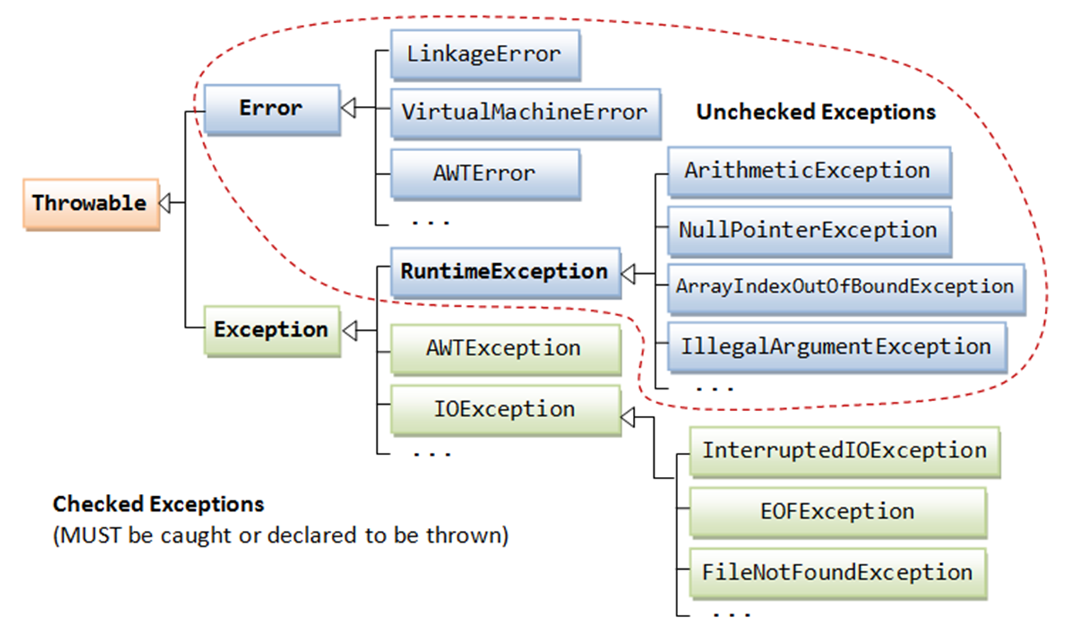
Throwable Class
All exception and error types are subclasses of the class Throwable, which is the base class of the exception hierarchy.
One branch is headed by Exception. This class is used for exceptional conditions that user programs should catch.
NullPointerException is an example of such an exception.
Another branch, Error is used by the JVM to indicate errors having to do with the run-time environment (JRE), itself.
StackOverflowError is an example of such an error.

Slide 11
Common methods in Throwable
String getMessage(): Returns the detail message string of this throwable.
Throwable getCause(): Returns the cause of this throwable or null if the cause is nonexistent or unknown.
String toString(): Returns a short description of this throwable.
void printStackTrace(): Prints the throwable and its backtrace to the standard error stream.
class ThrowableExample {
public static void main(String[] args) {
try {
int result = 10/0;
} catch (ArithmeticException e) {
System.out.println("Message: " +
e.getMessage());
System.out.println("Cause: " +
e.getCause());
System.out.println("Exception: "
+ e.toString());
e.printStackTrace();
}
}
}
Output:
Message: / by zero
Cause: null
Exception: java.lang.ArithmeticException: / by zero
java.lang.ArithmeticException: / by zero
at Main.main(Main.java:4)

Slide 12
Types of Exception
The two main types of exceptions are:
Checked Exceptions (Compile-time Exceptions)
Unchecked Exceptions (Runtime Exceptions)
Checked Exceptions:
Checked exceptions are exceptions that are checked by the Java compiler at compile time.
Programs are required to either catch (handle) checked exceptions using a try-catch block or declare them using the throws.
Common examples of checked exceptions include IOException, SQLException, and ClassNotFoundException. These exceptions often relate to external factors, such as file I/O, database access, and class loading.
Unchecked Exceptions:
Unchecked exceptions are exceptions that are not checked by the Java compiler at compile time.
Programs are not required to catch or declare unchecked exceptions. Instead, they are thrown and discovered at runtime.
Common examples of unchecked exceptions include ArrayIndexOutOfBoundsException, NullPointerException, ArithmeticException, etc. These exceptions often indicate programm-ing errors or unexpected conditions.

Slide 13
Different Exceptions in Java
Java Exceptions can be also categorized into two categories: built-in exceptions and user-defined exceptions.
Some common built-in exceptions in Java are:
ArithmeticException
IOException
NumberFormatException
ArrayIndexOutOfBoundsException
StringIndexOutOfBoundsException
NullPointerException
and many more…

Slide 14
ArithmeticException
ArithmeticException is thrown when an exceptional condition has occurred in an arithmetic operation.
class ArithmeticException_Example1 {
public static void main(String[] args) {
int a = 2;
int b = 0;
System.out.println("a modulo b: " +
a%b);
}
}
class ArithmeticException_Example2 {
public static void main(String[] args) {
int max = Integer.MAX_VALUE;
int result = Math.addExact(max, 1);
System.out.println("Result: " + result);
}
}
Output:
Exception in thread "main" java.lang.ArithmeticException: / by zero
at Main.main(Main.java:6)
Output:
Exception in thread "main" java.lang.ArithmeticException: integer overflow
at java.base/java.lang.Math.addExact(Math.java:825)
at Main.main(Main.java:4)

Slide 15
IOException
IOException is raised when an input-output operation failed or interrupted in a Java program.
import java.io.FileReader;
import java.io.IOException;
class IOException_Example {
public static void main(String[] args) {
//Attempt to read from a file that doesn't exist
FileReader reader = new FileReader("nonexistentfile.txt");
reader.close();
}
}
Output:
Error: unreported exception FileNotFoundException; must be caught or declared to be thrown
FileReader reader = new FileReader("nonexistentfile.txt");
^
Main.java:8: Error: unreported exception IOException; must be caught or declared to be thrown
reader.close();
^

Slide 16
NumberFormatException
NumberFormatException is raised when a method could not convert a string into a numeric format.
class NumberFormatException_Example {
public static void main(String[] args) {
int num = Integer.parseInt ("Student") ; //trying to assign a string
to an integer variable
System.out.println(num);
}
}
Output:
Exception in thread "main" java.lang.NumberFormatException: For input string: "Student"
at java.base/java.lang.NumberFormatException.forInputString(NumberFormatException.java:65)
at java.base/java.lang.Integer.parseInt(Integer.java:652)
at java.base/java.lang.Integer.parseInt(Integer.java:770)
at Main.main(Main.java:3)

Slide 17
ArrayIndexOutOfBoundsException
ArrayIndexOutOfBoundsException is thrown to indicate that an array has been accessed with an illegal index. The index is either negative or greater than or equal to the size of the array.
class ArrayIndexOutOfBound_Example {
public static void main(String args[]) {
int a[] = new int[5];
a[6] = 9; //accessing 7th element in an array of size 5
}
}
Output:
Exception in thread "main" java.lang.ArrayIndexOutOfBoundsException: Index 6 out of bounds for length 5
at Main.main(Main.java:4)

Slide 18
StringIndexOutOfBoundsException
StringIndexOutOfBoundsException is thrown by String class methods to indicate that an index is either negative or greater than the size of the string.
class StringIndexOutOfBound_Example {
public static void main(String args[]) {
String s = "This is like chipping "; //String length is 22
char ch = s.charAt(24); //accessing 25th element
System.out.println(ch);
}
}
Output:
Exception in thread "main" java.lang.StringIndexOutOfBoundsException: String index out of range: 24
at java.base/java.lang.StringLatin1.charAt(StringLatin1.java:47)
at java.base/java.lang.String.charAt(String.java:693)
at Main.main(Main.java:4)

Slide 19
NullPointerException
NullPointerException is thrown when referring to the members of a null object. Null represents nothing.
class NullPointerException_Example {
public static void main(String args[]) {
String s = null; //null value
char ch = s.charAt(0); //accessing first element of the string
System.out.println(ch);
}
}
Output:
Exception in thread "main" java.lang.NullPointerException
at Main.main(Main.java:4)

Slide 20
Summary
Today, we learned about
Concept of Errors in Java
Concept of Exceptions in Java
Throwable Class
Types of Exceptions
Some common exceptions (ArithmeticException, IOException, NumberFormatException, ArrayIndexOutOfBoundsException, StringIndexOutOfBoundsException, NullPointerException, etc.)

Slide 21


